Slide 1
Structural causal model for leveraging observational data (EHR, Device data) complementary to randomized controlled trial(RCT)
Yonghan Jung^{1,3}
Mohammad Adibuzzaman³
Yuehwern Yih^{1,3}
Elias Bareinboim⁴
Marvi Bikak²
¹School of Industrial Engineering, Purdue University, West Lafayette, USA
²Indiana University School of Medicine, Indianapolis, USA ³Regenstreif Center for Healthcare Engineering, Purdue University, West Lafayette, USA
⁴Department of Computer Science, Purdue University, West Lafayette, USA

Slide 2
Randomized controlled trial: gold standard for evidence based medicine
1962 Drug Amendments Law for FDA
“All drugs should be approved on the basis of well-controlled experimental study”.
RCT became a gold standard for clinical trial
Why?
Causal inference by
Removing confounding bias and selection bias.
Notes:
“adaptation” instead of enforced.

Slide 3
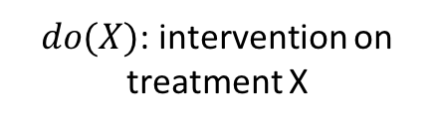
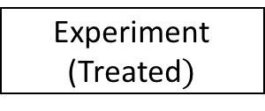
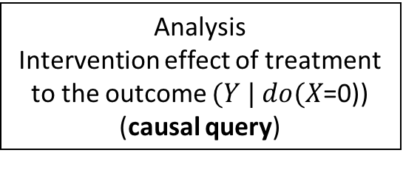
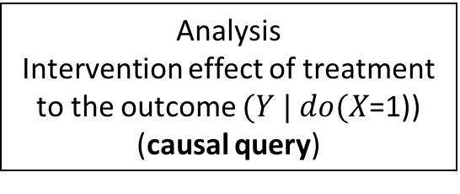
randomized control trial
effect of treatment /drug on outcome?”
To remove confounding bias
Demographic (age / sex / race)
Physiological (heart rate, etc.)
Sociological (income)
Etc.
Randomizing patients (coin tossing!)
Experiment
(Treated$)$
Control
(Non-treated)
$do(X)$: intervention on treatment X
Analysis
Intervention effect of treatment to the outcome $(Y | do(X$=1)) (causal query)
Analysis
Intervention effect of treatment to the outcome $(Y | do(X$=0)) (causal query)

Slide 4
Limitations of randomized controlled trial
Ethical/safety issues
Target patients are pregnant woman
Smoking / Non-smoking?
Limited samples
Limited number of patients.
Sampling selection bias
Cost
Time
Money

Slide 5
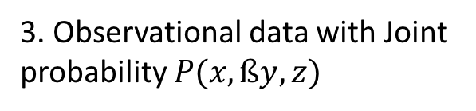
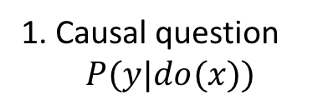
Alternative to rct: observational data
Question: Is it possible to conduct virtual experimental study by using 1) clinical knowledge and 2) observational data?
1. Causal question
$$P(y|do(x))$$
Challenge
1. How to derive structure (model) from observational data?
2. Model based on clinical knowledge
Z
Confounders
2. How to answer causal question given structure from observational data without confounding bias?
Treatment
X
Y
Outcome
3. Observational data with Joint probability $P(x,ßy,z)$

Slide 6
explore SCM to answer the causal question
Explore Structural Causal Model (SCM) to answer the causal question with attenuating the challenges.
Why?
Graphical encoding of clinical knowledge (transparency and flexibility)
Algorithmically derivation of formula (Causal diagram in, Formula out)

Slide 7
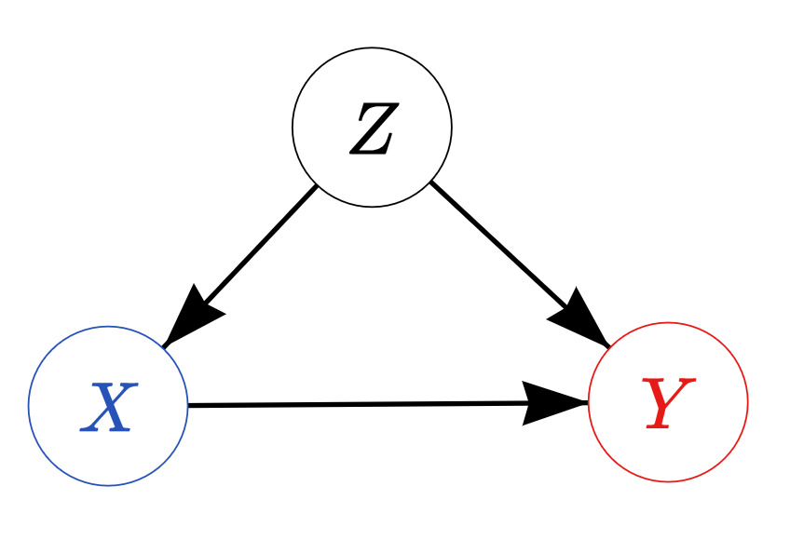
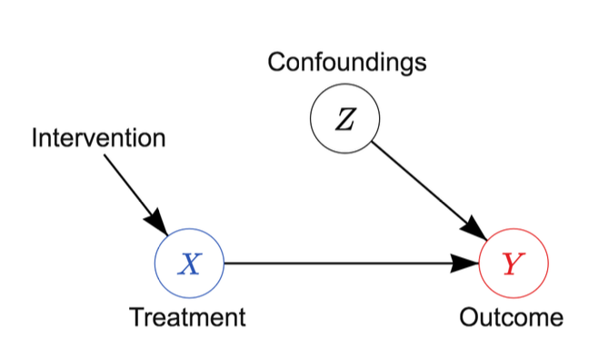
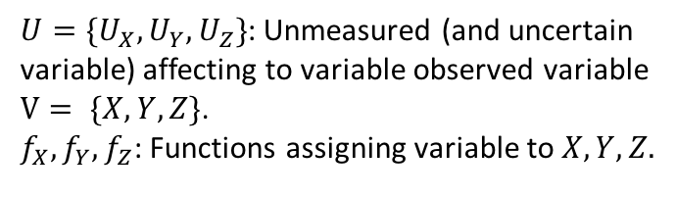
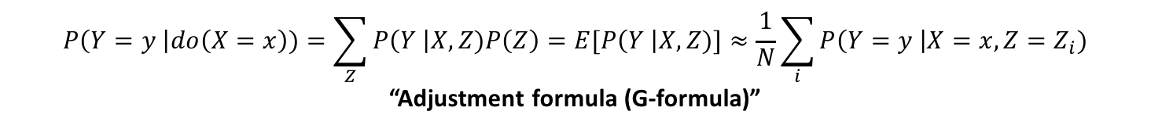
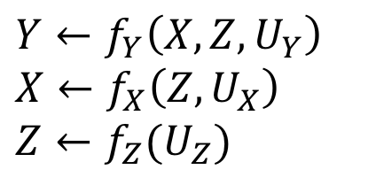
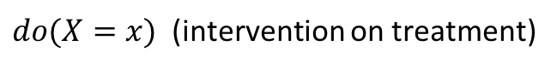
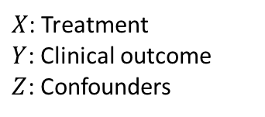
Definition of SCM : <G, F, V, U>
Causal diagram (Structures)
Specifying relationship between variables.
Structural equations
A model about the relationship.
$X$: Treatment
$Y$: Clinical outcome
$Z$: Confounders
$$Y←f_{Y}\left(X,Z,U_{Y}\right)$$
$$X←f_{X}\left(Z,U_{X}\right)$$
$$Z←f_{Z}(U_{Z})$$
$U=\{U_{X}, U_{Y}, U_{Z}\}$: Unmeasured (and uncertain variable) affecting to variable observed variable $V= \{X,Y,Z\}$.
$f_{X}, f_{Y},f_{Z}$: Functions assigning variable to $X,Y,Z.$
$do(X=x)$ (intervention on treatment)
$$P\left(Y=y \right|do\left(X=x\right))=\sum_{Z}{P\left(Y \right|X,Z)P\left(Z\right)=E[P\left(Y \right|X,Z)]}≈\frac{1}{N}\sum_{i}{P\left(Y=y \right|X=x,Z=Z_{i})}$$
“Adjustment formula (G-formula)”

Slide 8
Summary of our clinical topic
Summary of our clinical topic and notion
Disease: Acute Respiratory Distress Disease (Lung cell out-of-order, so one cannot breathe by him/herself).
Treatment: Mechanical ventilator (a machine for helping one to breathe) setting.
Tidal volume (VT): amount of the air capacity of lung (control CO2 in blood)
Positive End Expiratory Pressure (PEEP) : Default air pressure after exhaling (control O2 in blood)
Plateau pressure (PP): Air pressure when inhaled and holding a breathe.
FiO2: % of oxygen in the air.
Outcome: Mortality rate (28 / 60 / 90 days after the onset).

Slide 9
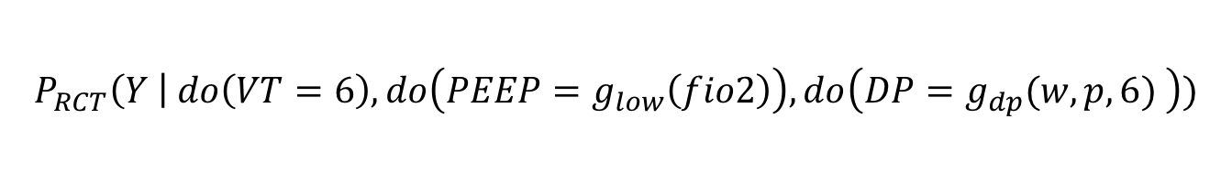
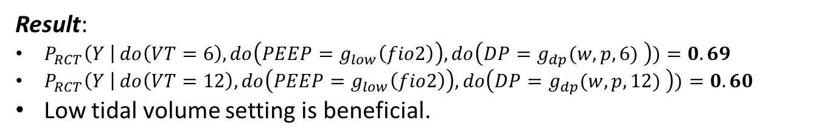
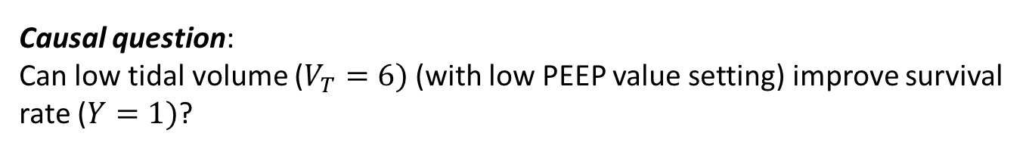
RCT 1: ARMA trial (ARDS Network 2000)
Causal question:
Can low tidal volume ($V_{T}=6)$(with low PEEP value setting) improve survival rate ($Y=1)$?
Other mechanical ventilation setting values fixed same for both group ($PEEP, FiO_{2})$ . $f$ and $w$ is a realization of random variable FiO2 and Weight.
$$P_{RCT}\left(Y \right| do\left(VT=6\right),do\left(PEEP=g_{low}\left(fio2\right)\right),do\left(DP=g_{dp}(w,p,6) \right))$$
Result:
$P_{RCT}\left(Y \right| do\left(VT=6\right),do\left(PEEP=g_{low}\left(fio2\right)\right),do\left(DP=g_{dp}(w,p,6) \right))=0.69$
$P_{RCT}\left(Y \right| do\left(VT=12\right),do\left(PEEP=g_{low}\left(fio2\right)\right),do\left(DP=g_{dp}(w,p,12) \right))=0.60$
Low tidal volume setting is beneficial.

Slide 10
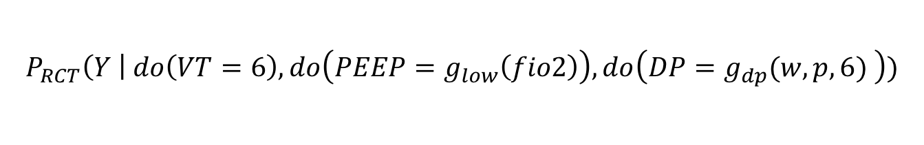
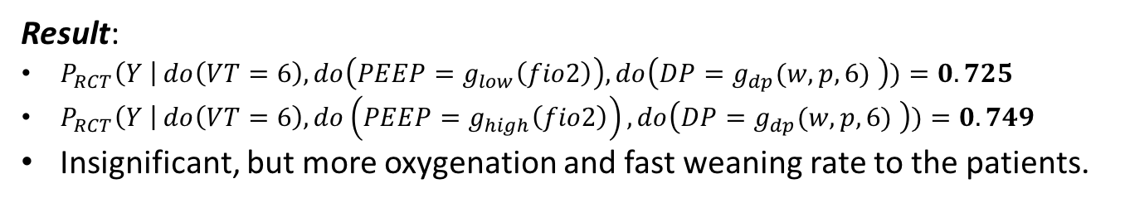
RCT2:ALVEOLI trial (ARDS network 2004)
Causal question:
Can high Positive End Expiratory Pressure (PEEP) value improve survival rate?
Other mechanical ventilation setting values fixed same for both group ($PEEP, FiO_{2})$ . $f$ and $w$ is a realization of random variable FiO2 and Weight.
$$P_{RCT}\left(Y \right| do\left(VT=6\right),do\left(PEEP=g_{low}\left(fio2\right)\right),do\left(DP=g_{dp}(w,p,6) \right))$$
Result:
$P_{RCT}\left(Y \right| do\left(VT=6\right),do\left(PEEP=g_{low}\left(fio2\right)\right),do\left(DP=g_{dp}(w,p,6) \right))=0.725$
$P_{RCT}\left(Y \right| do\left(VT=6\right),do\left(PEEP=g_{high}\left(fio2\right)\right),do\left(DP=g_{dp}(w,p,6) \right))=0.749$
Insignificant, but more oxygenation and fast weaning rate to the patients.

Slide 11
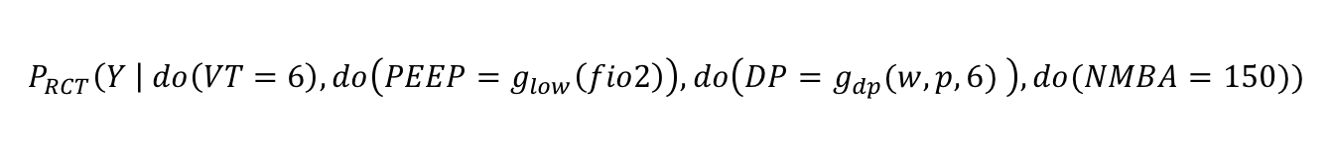
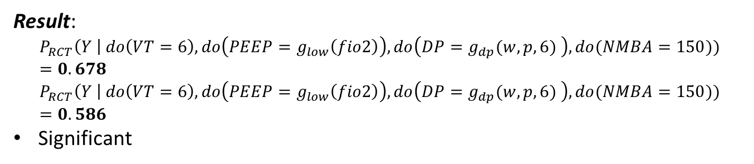
RCT3: ACURASYS trial (Papazian 2010)
Causal question:
Can treatment of NMBA (cisatracurium) treatment improve survival rate to more severe patients?
Other mechanical ventilation setting values fixed same for both group ($PEEP, FiO_{2})$ . $f$ and $w$ is a realization of random variable FiO2 and Weight.
$$P_{RCT}\left(Y \right| do\left(VT=6\right),do\left(PEEP=g_{low}\left(fio2\right)\right),do\left(DP=g_{dp}(w,p,6) \right), do(NMBA=150))$$
Result:
$$P_{RCT}\left(Y \right| do\left(VT=6\right),do\left(PEEP=g_{low}\left(fio2\right)\right),do\left(DP=g_{dp}(w,p,6) \right), do(NMBA=150))=0.678$$
$$P_{RCT}\left(Y \right| do\left(VT=6\right),do\left(PEEP=g_{low}\left(fio2\right)\right),do\left(DP=g_{dp}(w,p,6) \right), do(NMBA=150))=0.586$$
Significant

Slide 12
Experiment design
MIMIC3 – open ICU Electronic Healthcare record
Clinical Database
Waveform Database
Matched
Subset
58,000 Hospital Admission
2001-2012
Nurse entered physiology
Medications
Laboratory data
Nursing notes
Discharge notes
Format: CSV, SQL
~40GB
23,180 Records
2001-2012
Waveforms
ECG
Blood pressure
Plethysmography
Format: Text, Matlab
~3TB Compressed
4,897 Waveform and 5,266 Numeric records matched with 2,809 clinical records

Slide 13
Experiment design – cohort selection
Inclusion criteria
ARDS patients
Mechanical ventilated (MV).
(PaO2: FiO2) <= 300 (Berlin score) at any time Within 48 hours of ICU admission (closest measurement)
A
Include patients Age >= 18
Exclude patients with congestive heart failure by ICD-9 code.
Include If CB is administered after Berlin score is measured or CB is not administered
Inclusion criteria
B
Yes
No
C
Cisatracurium Besylate (CB)
D
Death in 90 days after the last day of CB taken
No
Death within 90 days of the last use of MV?
F
H
Yes
E
G
4050

Slide 14
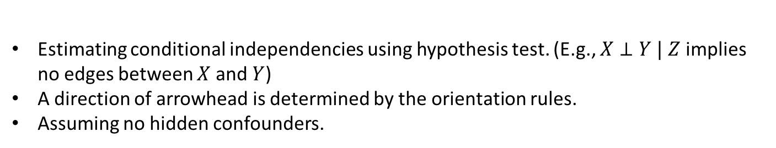
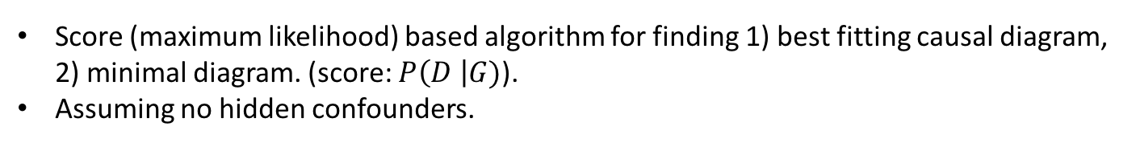
Learning structure (causal diagram)
PC algorithm
Estimating conditional independencies using hypothesis test. (E.g., $X⊥Y | Z$ implies no edges between $X$ and $Y$)
A direction of arrowhead is determined by the orientation rules.
Assuming no hidden confounders.
GES algorithm
Score (maximum likelihood) based algorithm for finding 1) best fitting causal diagram, 2) minimal diagram. (score: $P\left(D \right|G)$).
Assuming no hidden confounders.
FCI algorithm
A modification of the PC algorithm that drops ’no hidden confounders’ assumption.
Edge selection rule
Edges voted by majority of algorithms, without conflicting medical knowledge, were chosen.
Verification by medical experts

Slide 15
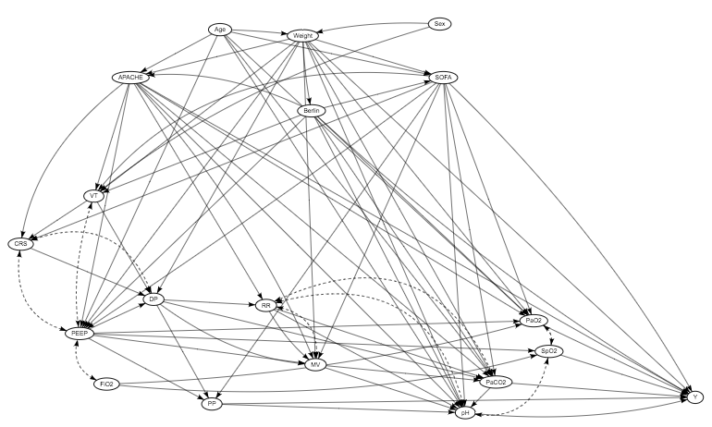
Causal diagram generation

Slide 16
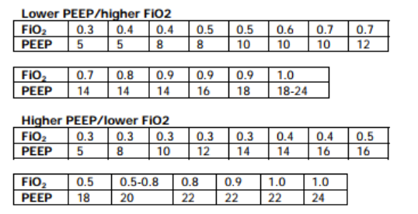
Specification of intervention (ARDS network protocol)
Ventilator setup and adjustment
Compute predicted body weight (PBW) / Mode: volume control
Starting from VT=8ml/PBW ➔ 6ml/PBW.
Adjust to achieve PaO2: 55-80 / SpO2 88-95%, PP <= 30.
Use Minimum PEEP 5.
PIP?

Slide 17
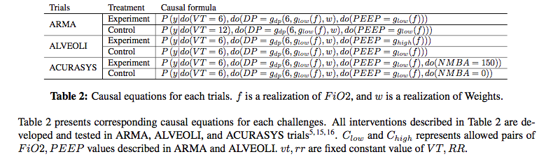
Comparison with RCT

Slide 18
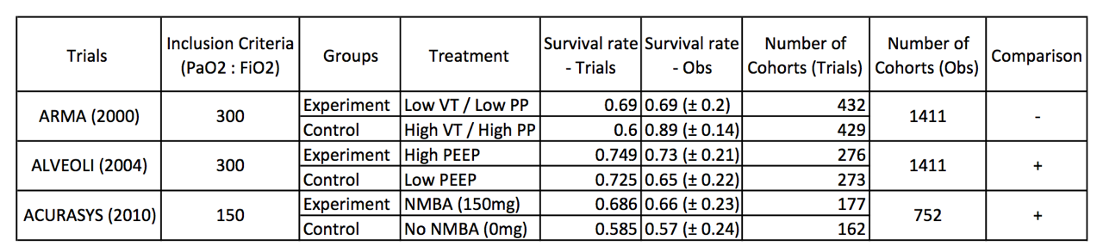
Comparison with RCT - 2

Slide 19
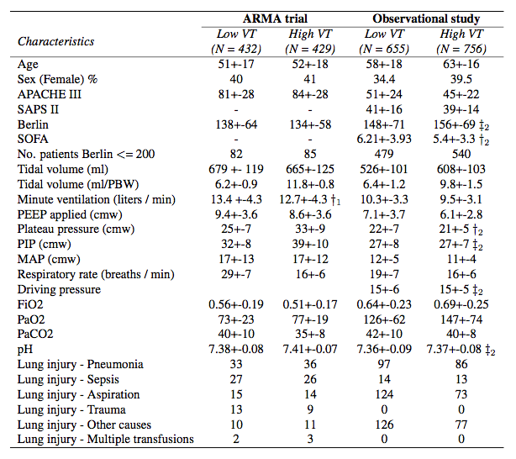
Heterogeneity in baseline characteristics - ARMA

Slide 20
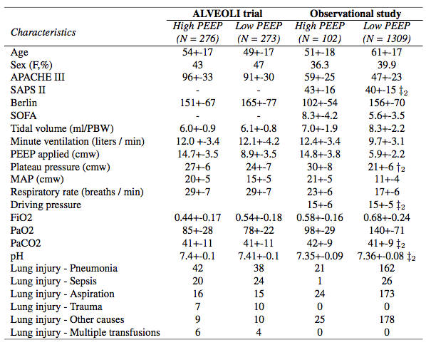
Heterogeneity in baseline characteristics - ALVEOLI

Slide 21
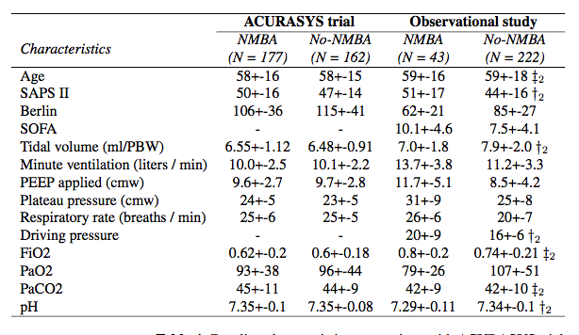
Heterogeneity in baselin characteristics - ACURASYS

Slide 22
Research direction
Summary
Our goal: Develop and demonstrate a systemic procedure to conduct virtual experiment.
Contribution: Introduce SCM to the medical domain, which SCM is not broadly used even if its advantage in explicitly incorporating clinical knowledge and providing broader chance to analyze data.

Slide 23
Research direction
Research direction
1. Personalized ventilation strategy.
2. Treatment – Treatment interaction
3. Sequential treatment allocation

Slide 24
Causal assumption from other literatures
References
Papazian et al., (2010) “Neuromuscular Blockers in Early Acute Respiratory Distress Syndrome,” New England Journal of Medicine
Brower, Roy G., et al. "Higher versus lower positive end-expiratory pressures in patients with the acute respiratory distress syndrome." The New England journal of medicine 351.4 (2004): 327.
Amato, M. B. P., et al. "Ventilation with lower tidal volumes as compared with traditional tidal volumes for acute lung injury." N. Engl. J. Med 343.2000 (2000): 812-814.
Shpitser, I., & Pearl, J. (2006). Identification of joint interventional distributions in recursive semi-Markovian causal models. In Proceedings of the National Conference on Artificial Intelligence (Vol. 21, No. 2, p. 1219). Menlo Park, CA; Cambridge, MA; London; AAAI Press; MIT Press; 1999.

Slide 25
Mixing rate as a measure of hemorrhagic vulnerability in intensive care unit (ICU) patients experiencing acute hypotensive episodes (AHE)
Brett Collar^{1,2}
Mohammad Adibuzzaman¹
Paul Griffin^{1,3}
¹Regenstrief Center for Healthcare Engineering, Purdue University, West Lafayette, USA
²School of Biomedical Engineering, Purdue University, West Lafayette, USA
³School of Industrial Engineering, Purdue University, West Lafayette, USA

Slide 26
Outline
Problem Description
Background
Mathematical Concepts
Shock Index (SI)
Animal Study (Previous Work)
Data
Algorithm
Results
Translational Study (Current Work)
Data
Approach
Results/Conclusion

Slide 27
Problem Description

Slide 28
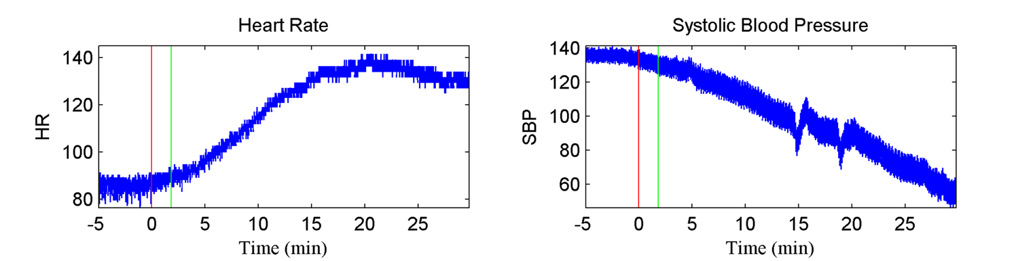
Hemorrhage, ahe and death
Hemorrhage leads to acute hypotensive episode (AHE) or shock, and shock leads to death.
Notes:
When regulatory mechanisms fail, shock happens:
Blood pressure remains unchanged for a long time
Heart rate increases (to compensate for low circulation and keep BP unchanged)
Eventually, blood pressure “craters”
However, many patients have reactions that do not follow this pattern, making shock diagnosis tricky

Slide 29
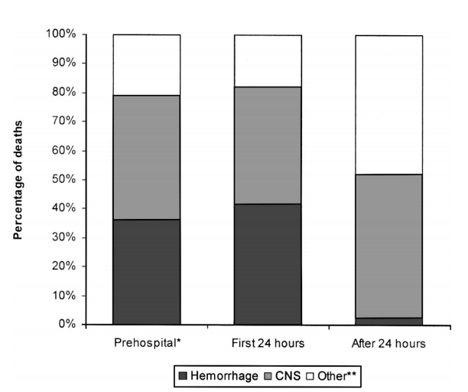
Problem Description
A METHOD IS NEEDED TO IDENTIFY PATIENTS THAT REQUIRE IMMEDIATE MEDICAL CARE
Hemorrhage results in over 80% of operating room deaths after major trauma [2]
Almost 50% of deaths in the first 24 hours of trauma care are due to hemorrhage [2]
Heart rate, mean arterial pressure, and shock index poorly predict the need for continued resuscitation and the effectiveness of treatment [1]
[2]
Notes:
Figure shows the causes of death at various phases of a patient’s stay in the hospital
- Prehospital ranges from before EMS arrive to before arriving at the hospital
- Other** deaths include combinations of hemorrhage/CNS injury
Problem Description
What is hemorrhage? Bleeding – blood escaping from the circulatory system
Causes: Different types of trauma (blunt, penetrating), medical procedures, coagulation disorders
Hemorrhage can lead to a host of complications, and eventually death
Why is it important to treat?
Hospital emergency departments
Triage situations
Battlefield treatment

Slide 30
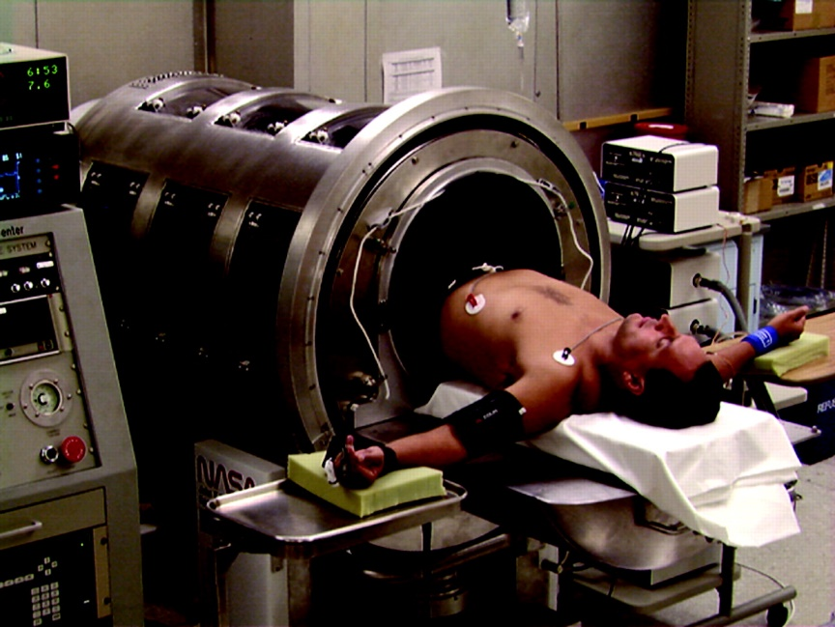
State of the art
Compensatory reserve index (cri)
Require ~30 heartbeats of baseline patient data
Estimates the remaining proportion of physiological reserve available to compensate for loss of blood volume [3]
Compares individual waveforms to a large library of reference waveforms (using lower body negative pressure (LBNP))
[3]
Notes:
Lower body negative pressure causes increased retention of blood in lower body, resulting in reduction of central blood volume
- Meant to imitate a hypotensive episode in the patient’s upper body
Goals:
Prospectively identify ongoing loss of blood volume [1]
Estimate the point at which individuals would experience hemodynamic decompensation well in advance compared to traditional vital signs

Slide 31
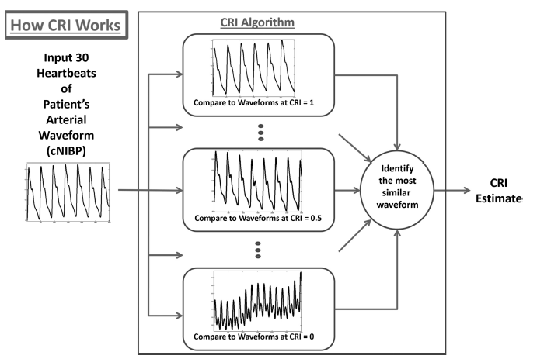
State of the art
CRI Algorithm
[3]
Notes:
1. ~30 heartbeats of baseline patient data
2. Compares individual waveforms to a large library of reference waveforms of different physiological reserves
3. Identify the most similar waveform
CRI normalized on a scale of 1 to 0
1 reflects maximum capacity of physiological mechanisms to compensate for reduced central blood volume
0 represents imminent cardiovascular instability and decompensation

Slide 32
Background

Slide 33
Markov Chain
Notes:
A process satisfies the Markov property predictions for the future of the process can be based solely on its present state, hence independently from history
Theory of a Markov chain is that the next value of a sequence depends solely on the current state
Future states can be predicted by creating a transition probability matrix

Slide 34
Eigenvalues
Notes:
Eigenvalues and left eigenvectors are determined from the transpose of the transition probability matrix [4]
The transition matrix P, if N x N, has N eigenvalues, all eigenvalues are on or inside the unit circle in the complex plane [5]
| A – λI | → Solving for eigenvalues
Eigenvalue == λ
Eigenvector == v

Slide 35
Mixing Rate
Notes:
SLEM = Second Largest Eigenvalue of the Markov Chain
The eigenvalue with the second largest magnitude is defined as the mixing rate
Represents the rate of convergence of the Markov chain to the uniform equilibrium distribution
Stationary distribution == limiting distribution
Stationary distribution → As the number of steps goes to infinity, the distribution over states converges to π (the eigenvector for which the eigenvalue is 1)

Slide 36
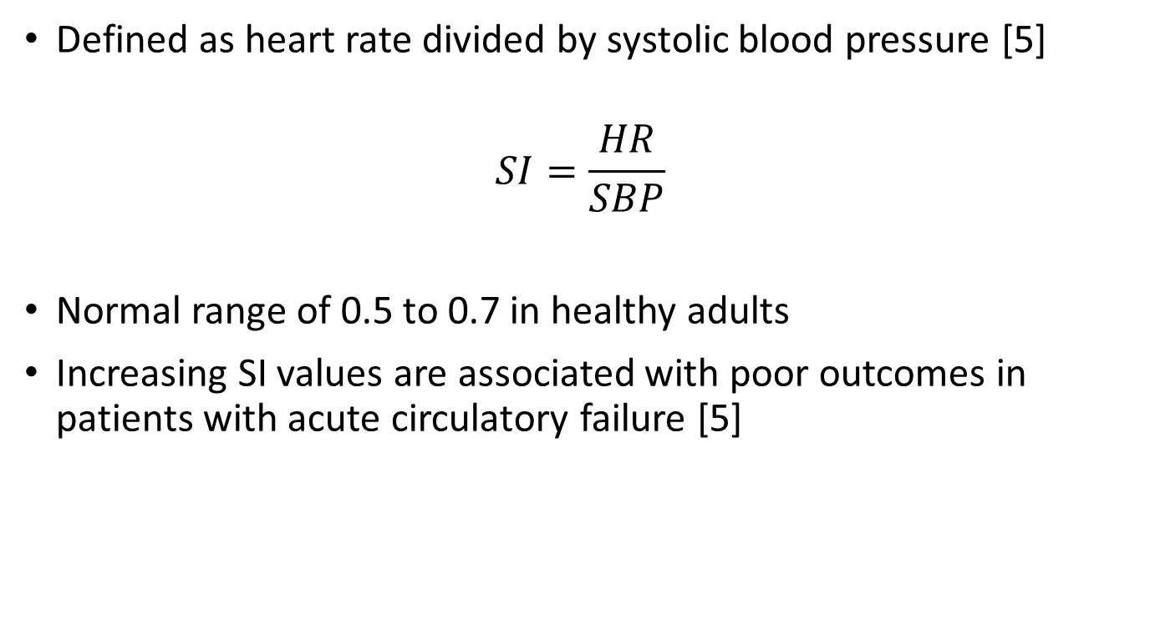
Shock Index (SI)
Defined as heart rate divided by systolic blood pressure [5]
$$SI=\frac{HR}{SBP}$$
Normal range of 0.5 to 0.7 in healthy adults
Increasing SI values are associated with poor outcomes in patients with acute circulatory failure [5]
Notes:
Used to identify high-risk septic patients
SI increases because heart rate increases to compensate, and BP eventually decreases

Slide 37
Animal Study (Previous Work)

Slide 38
Animal study: data
Immature swine (N=7)
Underwent continuous hemorrhage of 10 ml/kg over 30 minutes as SBP was recorded [4]
Eigenvalues were calculated for each window of 2000 samples (20 seconds)
Correlation coefficients determined between mixing rate and each vital sign (HR, SBP, PP, shock index)

Slide 39
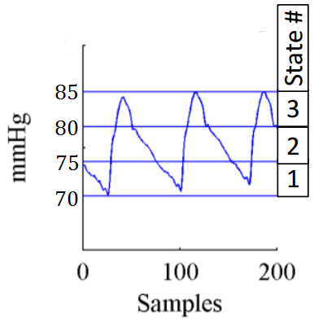
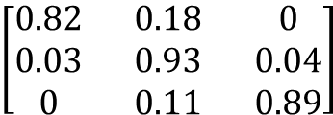
Algorithm
State 2 (75-80 mmHg)
$$\left[\begin{matrix}0.82 & 0.18 & 0 \\ 0.03 & 0.93 & 0.04 \\ 0 & 0.11 & 0.89\end{matrix}\right]$$
State 1 (70-75 mmHg)
State 3 (80-85 mmHg)
[4]
Arterial Blood Pressure
Markov Chain
Transition Probability Matrix
Notes:
From the waveform dataset, a Markov chain transition probability matrix is created
Create a matrix of m×m states, where the entry at the i^{th} row and j^{th} column represents the probability for which blood pressure changes from the i^{th} to the j^{th} state

Slide 40
Algorithm
Second largest eigenvalue, or the mixing rate of the transition probability matrix was computed
Notes:
Eigenvalues are calculated from the transpose of the transition probability matrix
Second largest eigenvalue is defined as the mixing rate

Slide 41
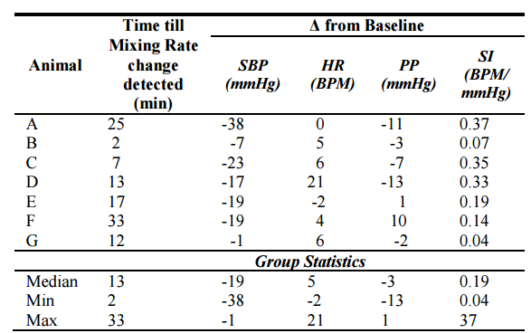
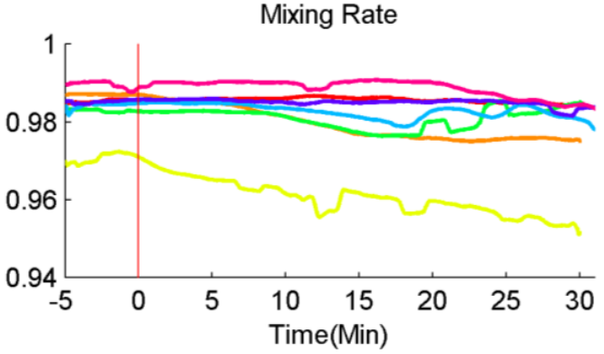
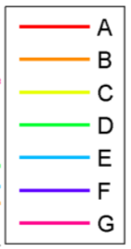
Animal study: Results
Mixing rates from each successive transition probability matrix are compiled into a single graph [4]
[4]
[4]
Notes:
SLEMs from successive windows (2000 samples) are plotted to make a single graph of mixing rate
Significant changes in mixing rate can be calculated from this graph
Table shows the median time that a significant change is detected using the mixing rate metric in swine compared to the change in shock index since baseline

Slide 42
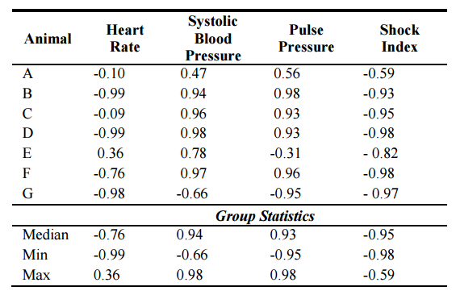
Animal study: Results
Correlation coefficients
[4]
Notes:
This table displays the correlation coefficients between mixing rate and HR, SBP, PP, and SI
- Shock index had an inverse correlation greater than 0.5 for all 7 swine samples

Slide 43
Translational Study (Current Work)
Does the algorithm work with Humans?

Slide 44
Translational study: Challenge Data
CINC Challenge Data 2009
Minute by minute data
Acute hypotensive episode (AHE) is defined a period of 30 minutes or more during which at least 90% of the mean arterial pressure (MAP) measurements were at or below 60 mmHg
Training data
Four groups, 15 records for each group
Group H1 (acute hypotensive episode in forecast window, treated with pressors)
Group H2 (AHE in forecast window, not treated with pressors)
Group C1 (records not containing acute hypotensive episodes)
Group C2 (AHE, but not in forecast window)
Notes:
In our research, we only considered patients in groups H1 and H2, as they were the only ones with identifiable hypotensive episodes

Slide 45
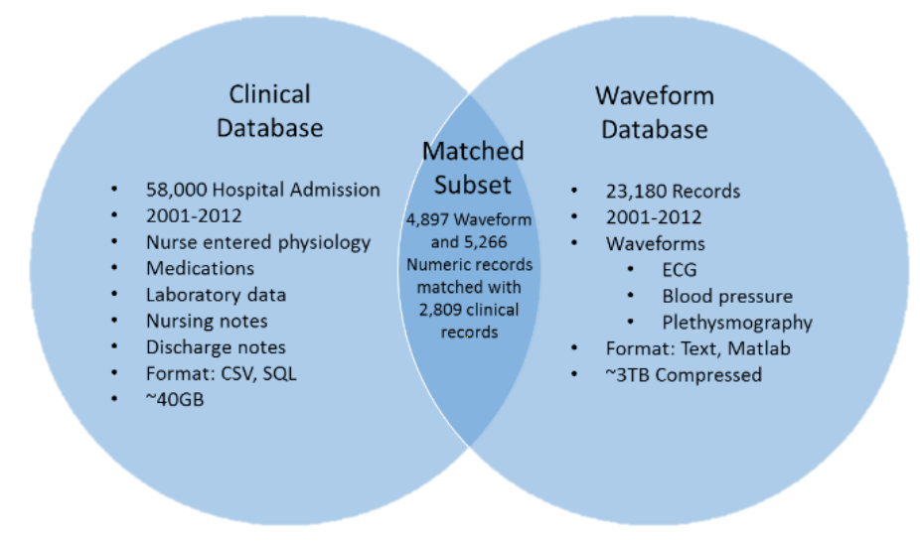
Translational study: mimic database
MIMIC Data
MIMIC II Waveform Database Matched Subset [6]
Challenge data in Matched Subset
Clinical records (SBP, DBP, MAP, HR) – 1 reading per minute [7]
Waveform records (ECGs, continuous blood pressure waveforms) – 125 samples per second [7]
[6]
Notes:
CINC Challenge Data came from the MIMIC II Waveform Database Matched Subset
Clinical records (1 per minute) → Used to calculate shock index
Waveform records (125 per second) → Used to calculate mixing rate
Use Matlab for waveform analysis

Slide 46
Translational study: Patient Data
MIMIC II Waveform database matched subset
Example Patient BP Waveform Data (125 Hz, ~72 hours total data, T₀ known):
T₀
(onset of forecast window)
Observation Window
(noncritical, 10 minutes)
AHE of Interest
(~30 minutes into Forecast Window)
Forecast Window
(60 minutes)
10 minutes prior to onset of forecast window to establish baseline
60 minutes of data in forecast window (AHE ~30 minutes into forecast window)
Notes:
What do we do with this database?
Find location of T₀ in dataset (given)
Collect 10 minutes of data prior to T₀ to establish baseline
Collect 60 minutes of data after T₀, find first instance of significant change to mixing rate
Approximately 30 minutes into forecast window

Slide 47
Translational Study: Results

Slide 48
Patient Waveforms
30 patient waveforms provided in the MIMIC III Database
23 patients had identifiable locations for T₀ in their waveform records
15 patients were visually identified to fit criteria of a decreased MR at AHE compared to baseline values
These 15 patients constitute the selected cohort
11 patients had AHEs with acceptable levels of noise/time since T₀
Mixing rate, shock index, heart rate, and systolic blood pressure waveforms were generated for all 15 patients in the selected cohort

Slide 49
Patient MR waveforms
Notes:
Background: 11 patient MR waveforms that fit criteria and do not contain excessive noise around AHE
Blue line: Average of all 11 patient waveforms

Slide 50
Patient SI Waveforms
Notes:
Shock index currently used to identify risk of patient outcomes

Slide 51
Patient HR Waveforms
Notes:
SI = HR / SBP

Slide 52
Patient SBP Waveforms
Notes:
SI = HR / SBP

Slide 53
Correlation coefficients
Correlation coefficients were calculated for all 23 patient waveforms
Calculations occurred from 10 minutes before T₀ to the acute hypotensive episode (AHE)
Correlation coefficients were obtained for SBP, SI, and HR
Patients organized in order of % change in MR (from baseline to AHE)
Notes:
AHEs were defined as the point from T0 to the end of the record that had the highest calculated shock index (SI = HR/SBP)
SBP, SI, and HR all obtained from numeric records on the MIMIC II Matched Database

Slide 54
Correlation coefficients with SBP, SI, and HR
Patient Number | SBP | Shock Index | Heart Rate | % Change MR (Baseline)
s19603 | 0.8193 | -0.8077 | -0.6748 | -0.2251%
s20658 | 0.5753 | -0.3518 | 0.2386 | -0.2023%
s22466 | -0.0078 | -0.0092 | 0.038 | -0.1358%
s23641 | 0.0158 | 0.0025 | 0.0239 | -0.0863%
s07125 | 0.5982 | -0.5942 | -0.7056 | -0.0735%
s20794 | 0.8584 | -0.8684 | Unavailable | -0.0726%
s12821 | 0.1294 | -0.2914 | -0.347 | -0.0573%
s02172 | 0.0876 | -0.1124 | -0.1619 | -0.0564%
s06349 | 0.7082 | -0.6724 | 0.5065 | -0.0386%
s21817 | 0.0058 | -0.0045 | -0.0248 | -0.0100%
s02395 | -0.4325 | 0.4357 | -0.0513 | 0.0129%
s23015 | -0.5404 | 0.4586 | -0.2274 | 0.0227%
s08718 | -0.6418 | 0.4193 | -0.5952 | 0.0257%
s25699 | -0.3199 | 0.332 | 0.172 | 0.0502%
s23594 | -0.1319 | 0.1455 | -0.0487 | 0.1011%
s15687 | -0.8177 | 0.6248 | -0.857 | 0.1149%
s05336 | -0.5601 | 0.3381 | -0.0564 | 0.1695%
s08779 | -0.5804 | 0.6766 | 0.0041 | 0.1790%
s24924 | -0.8445 | 0.815 | -0.5856 | 0.1888%
s19208 | -0.2093 | 0.3965 | 0.0088 | 0.2269%
s26105 | -0.9338 | 0.9018 | -0.8893 | 0.3470%
s23591 | -0.7713 | 0.7657 | -0.7379 | 0.3896%
s24799 | -0.6318 | 0.5606 | -0.6767 | 0.4338%
Notes:
Sorted according to % change in mixing rate
Bold rows signify the 15 patients that were visually identified as fitting the criteria for decreased MR
Red text signifies 4 patient samples that had too much noise to be considered useful
Animal model showed positive correlations to SBP, negative correlations to SI, and negative correlations to HR
4 Patients showed similarly high correlations in all three categories
Why do some patients follow the results of the swine study so closely, but not others?

Slide 55
Clinical hypotheses for change in mixing rate
Patient Number | Diagnosis | Age | Gender | Pressors?
s19603 | Acute Myocardial Infarction | 80 | F | No Pressors
s20658 | "Status Post" Abdominal Aortic Aneurysm (AAA) | 73 | F | Pressors
s22466 | Myocardial Infarction, Respiratory Distress | 78 | F | Pressors
s23641 | Acute Myocardial Infarction | 90 | M | No Pressors
s07125 | Gastroparesis\J-Tube Placement (Jejunostomy) | 51 | M | Pressors
s20794 | "Rule Out" Myocardial Infarction | 84 | M | Pressors
s12821 | Congestive Heart Failure, Pneumonia | 80 | F | Pressors
s02172 | Interstitial Pulmonary Fibrosis | 34 | M | No Pressors
s06349 | Congestive Heart Disease | 90 | F | Pressors
s21817 | Congestive Heart Failure | 71 | F | No Pressors
s02395 | Coronary Artery Disease | 79 | F | No Pressors
s23015 | Critical Aortic Stenosis, Transplant Evaluation | 67 | M | No Pressors
s08718 | Respiratory Failure | 84 | M | Pressors
s25699 | Cirrhosis | 39 | M | Pressors
s23594 | Pneumonia, Respiratory Failure | 73 | F | No Pressors
s15687 | Congestive Heart Failure\Cath/SDA | 88 | F | No Pressors
s05336 | Coronary Artery Disease | 45 | M | Pressors
s08779 | Coronary Artery Disease | 56 | M | No Pressors
s24924 | Coronary Artery Disease | 81 | F | No Pressors
s19208 | Congestive Heart Failure | 81 | F | Pressors
s26105 | CVA, Congestive Heart Failure, Pneumonia | 48 | M | No Pressors
s23591 | Shortness of Breath, "Rule Out" Myocardial Infarction, Telemetry | 86 | M | No Pressors
s24799 | Coronary Artery Disease | 66 | M | Pressors
Acute Myocardial Infarction
"Status Post" Abdominal Aortic Aneurysm (AAA)
Myocardial Infarction, Respiratory Distress
Acute Myocardial Infarction
Gastroparesis\J-Tube Placement (Jejunostomy)
"Rule Out" Myocardial Infarction
Congestive Heart Failure, Pneumonia
Interstitial Pulmonary Fibrosis
Congestive Heart Disease
Congestive Heart Failure
Coronary Artery Disease
No Pressors
Pressors
Pressors
No Pressors
Pressors
Pressors
Pressors
No Pressors
No Pressors
No Pressors
Pressors
Pressors
No Pressors
No Pressors
Pressors
No Pressors
No Pressors
Pressors
Notes:
Selected Cohort
CVA = Cerebrovascular Accident
Demographic Similarities:
8 of the top 11 “criteria-fitting” patients suffered from myocardial infarctions or heart disease
16 of all 23 patients suffered from MIs or heart disease
5 of the top 7 “criteria-fitting” patients received pressors
4 of the bottom 6 “criteria-fitting” patients did not receive pressors

Slide 56
Clinical hypotheses for change In mixing rate
Diagnosis:
Myocardial infarctions and heart disease account for 8 of the top 11 “criteria-fitting” patients
Age:
Average age of 12 subjects with biggest change: 73 years
Average age of 11 subjects with smallest change: 68 years
Not statistically significant (p = 0.47)
Drug Administration:
Patients administered pressors (vasoconstrictors) account for 5 of the top 7 selected cohort
Patients not administered pressors account for 4 of the bottom 6 selected cohort
Notes:
Possible explanation for the drug administration is that patients needing pressors were experiencing anesthesia-like effects (similar to swine from previous study, which were anesthetized) → Leading to largest changes in mixing rates

Slide 57
Comparing Vital Sign Changes
Group Statistics of all Patients
 | Time | ΔSBP | ΔSI | ΔHR
Median | 46 | -23.94 | 0.25 | -0.56
Min | 3 | -147.35 | 0.08 | -25.21
Max | 59 | 4.41 | 2.40 | 18.63
Group Statistics of “Selected Cohort” Patients
 | Time | ΔSBP | ΔSI | ΔHR
Median | 45 | -19.42 | 0.20 | 2.59
Min | 3 | -147.35 | 0.09 | -6.09
Max | 58 | 4.41 | 2.40 | 18.62
Group Statistics of Swine Study
 | Time | ΔSBP | ΔSI | ΔHR
Median | 13 | -19 | 0.19 | 5
Min | 2 | -38 | 0.04 | -2
Max | 23 | -1 | 0.37 | 21
Notes:
ΔSBP == Change from baseline before T0
If -147.3455 mmHg outlier is removed, minimum SBP becomes -51.8 → Much closer to the -38 mmHg from the swine study

Slide 58
Conclusions
A subset of patients displayed correlation coefficients similar to swine study
No significant differences for age or gender
Administration of pressors could explain why some patients more closely resemble results from previous swine study
Notes:
4 patients out of 23 had high correlations in

Slide 59
Future Work

Slide 60
Future Work
Identify additional patients in the MIMIC II Database Matched Subset that have undergone AHE
Continue analyzing current dataset for patterns with patient characteristics
Explore additional factors that may have effects on the accuracy and efficacy of the model

Slide 61
Additional Patients suffering Hemorrhage in MIMIC ii Database
Patients were identified by the ICD9 diagnosis codes of hospital records
ICD9 Code 578.9 considered most relevant to hemorrhagic bleeding
ICD9 Code | Number of Patients Diagnosed | Number of Patients in Matched Subset
459.0 (Hemorrhage) | 156 | 19
431 (Brain (miliary) (nontraumatic)) | 729 | 79
429.89 (Cardiovascular) | 39 | 4
998.11 (Surgical procedure complications) | 1008 | 143
432.9 (Cranial) | 39 | 6
430 (Membrane (brain)) | 352 | 36
423.0 (Pericardium, Pericarditis) | 66 | 18
578.9 (GI Bleed) | 938 | 162
Total | 3327 | 472
ICD9 Code | Number of Patients Diagnosed | Number of Patients in Matched Subset
459.0 (Hemorrhage) | 156 | 19
431 (Brain (miliary) (nontraumatic)) | 729 | 79
429.89 (Cardiovascular) | 39 | 4
998.11 (Surgical procedure complications) | 1008 | 143
432.9 (Cranial) | 39 | 6
430 (Membrane (brain)) | 352 | 36
423.0 (Pericardium, Pericarditis) | 66 | 18
578.9 (GI Bleed) | 938 | 162
Total | 3327 | 472
Notes:
ICD9 Code 578.9 considered most relevant to hemorrhagic bleeding

Slide 62
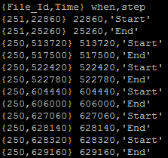
Additional patients suffering ahe from icd9 578.9
Utilized SciDB platform to process patient data
Applied algorithm to identify all AHE episodes within an individual subject’s hospital waveform
Example Output:
Time of Incidence (seconds)
File ID # of Waveform Record in Database
State of Incidence:
START – Onset of hypotensive episode
END – End of hypotensive episode
SINGLETON – Lone minute of AHE
Notes:
AHE episodes were identified according to minute-by-minute patient data of hospital records, then downloading high-frequency blood pressure waveforms for MR calculation

Slide 63
SCIDB R Program Data Analysis
Created R program to perform entire calculation process:
Identify patients with AHE and locate corresponding high-frequency file number
Download relevant high-frequency patient blood pressure data for identified window of AHE (including 60 minutes prior to onset of AHE)
Perform MR analysis on blood pressure data
Calculate correlation coefficients between MR and SBP, HR, and SI over entire sample

Slide 64
Patient AHE Data
162 ICD9 578.9 patients in matched subset, 47 analyzed:
8 patients found to suffer from AHE
Total of 81 hypotensive episodes identified within patient subset
Hypotensive episodes per patient ranged from 3 to 39

Slide 65
Correlation Coefficients of New Patient Data
Patient | Avg. Heart Rate Correlation | Avg. Systolic Blood Pressure Correlation | Avg. Shock Index Correlation
A | 0.07959601157 | 0.03768396642 | 0.0004311451379
B | -0.1198765981 | -0.08486558674 | -0.04757779805
C | -0.01502397621 | -0.04894702009 | -0.05558580767
D | -0.09486908437 | 0.01003627051 | 0.03668913713
E | -0.04365232787 | -0.390838561 | -0.3678173148
F | -0.02614974586 | -0.05002702797 | -0.04349202321
G | 0.04018569065 | -0.03655016186 | -0.03615903221
H | -0.00019358366 | 0.0232724723 | 0.0282115696

Slide 66
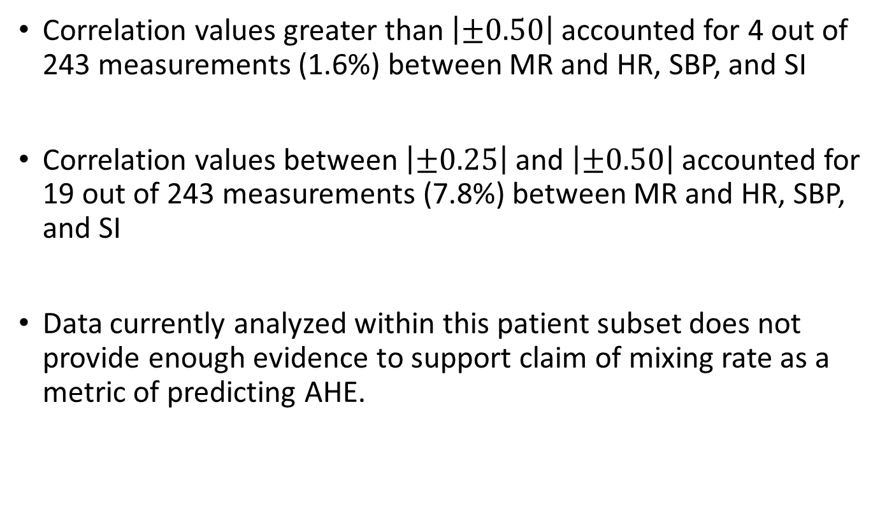
Conclusions
Correlation values greater than $\left|±0.50\right|$ accounted for 4 out of 243 measurements (1.6%) between MR and HR, SBP, and SI
Correlation values between $\left|±0.25\right|$ and $\left|±0.50\right|$ accounted for 19 out of 243 measurements (7.8%) between MR and HR, SBP, and SI
Data currently analyzed within this patient subset does not provide enough evidence to support claim of mixing rate as a metric of predicting AHE.

Slide 67
References
[1] M. Rady, E. Rivers, and R. Nowak, “Resuscitation of the critically ill in the ED: Responses of blood pressure, heart rate, shock index, central venous oxygen saturation, and lactate,” American Journal of Emergency Medicine, vol. 14, no. 2, pp. 218–225, Mar. 1996.
[2] D. S. Kauvar, R. Lefering, and C. E. Wade, “Impact of Hemorrhage on Trauma Outcome: An Overview of Epidemiology, Clinical Presentations, and Therapeutic Considerations,” The Journal of Trauma: Injury, Infection, and Critical Care, vol. 60, no. 6, pp. S3–S11, Jun. 2006.
[3] R. Nadler, V. A. Convertino, S. Gendler, G. Lending, A. M. Lipsky, S. Cardin, A. Lowenthal, and E. Glassberg, “The Value of Noninvasive Measurement of the Compensatory Reserve Index in Monitoring and Triage of Patients Experiencing Minimal Blood Loss,” Shock, vol. 42, no. 2, pp. 93–98, Mar. 2014.
[4] D. A. Levin, Y. Peres, E. L. Wilmer, J. Propp, and D. B. Wilson, Markov Chains and Mixing Times. Providence, RI: American Mathematical Society, 2017.
[5] M. Adibuzzaman, G. C. Kramer, L. Galeotti, S. J. Merrill, D. G. Strauss, and C. G. Scully, “The Mixing Rate of the Arterial Blood Pressure Waveform Markov Chain is Correlated with Shock Index During Hemorrhage in Anesthetized Swine,” 36th Annual International Conference of the IEEE Engineering in Medicine and Biology Society, pp. 3268–3271, Nov. 2014.
[6] S. J. Guastello, Nonlinear dynamical systems analysis for the behavioral sciences using real data. Boca Raton: CRC Press, 2011.
[5] M. Adibuzzaman, S. J. Merrill, and R. Povinelli, “A Systematic Approach for Algorithm Development for Identifying Changes in System Dynamics from Time Series ,” working paper.
[6] T. Berger, J. Green, T. Horeczko, Y. Hagar, N. Garg, A. Suarez, E. Panacek, and N. Shapiro, “Shock Index and Early Recognition of Sepsis in the Emergency Department: Pilot Study,” Western Journal of Emergency Medicine, vol. 14, no. 2, pp. 168–174, Jan. 2013.
[7] M. Adibuzzaman, K. Musselman, A. Johnson, P. Brown, Z. Pitluk, and A. Grama, “Closing the Data Loop: An Integrated Open Access Analysis Platform for the MIMIC Database,” 2016 Computing in Cardiology Conference (CinC), vol. 43, 2016.
[8] Goldberger AL, Amaral LAN, Glass L, Hausdorff JM, Ivanov PCh, Mark RG, Mietus JE, Moody GB, Peng C-K, Stanley HE. PhysioBank, PhysioToolkit, and PhysioNet: Components of a New Research Resource for Complex Physiologic Signals. Circulation 101(23):e215-e220; 2000 (June 13).

Slide 68
Closing the Data Loop: An Integrated Open Access Analysis Platform for the MIMIC Database
Mohammad Adibuzzaman¹, Ken Musselman¹, Alistair Johnson²,
Paul Brown³, Zachary Pitluk³, Ananth Grama⁴
¹Regenstrief Center for Healthcare Engineering, Purdue University, West Lafayette, USA
²Laboratory for Computational Physiology, Massachusetts Institute of Technology, Cambridge, USA
³Paradigm4, Waltham, USA
⁴Department of Computer Science, Purdue University, West Lafayette, USA
Mohammad Adibuzzaman, PhD
Assistant Research Scientist
madibuzz@purdue.edu

Slide 69
Research to translation: big data in healthcare
Big Data Preprocess
Reproduce/Evidence Based Medicine/FDA Approval
High Performance Computing
Publication
Analysis/Code

Slide 70

Janitor work?

Slide 71
Proposed architecture
Big Data
High Performance Computing
Analysis
Reproduce/Analysis
Publication
Publication
Evidence Based Medicine/FDA Approval

Slide 72
Multi-parameter Intelligent Monitoring in Intensive Care (MIMIC II)
MIMIC III
Clinical Database
Waveform Database
Matched Subset
58,000 Hospital Admission
2001-2012
Nurse entered physiology
Medications
Laboratory data
Nursing notes
Discharge notes
Format: CSV, SQL
~40GB
23,180 Records
2001-2012
Waveforms
ECG
Blood pressure
Plethysmography
Format: Text, Matlab
~3TB Compressed
4,897 Waveform and 5,266 Numeric records matched with 2,809 clinical records

Slide 73
Mimic iiI Access Platform
Clinical
PostgreSQL
CSV
Waveform
Physiobank ATM (one by one)
Rsync (batch) (install rsync in Ubuntu by the command)
sudo apt-get -y install rsync
Matlab WFDB (Waveform database) toolbox
rdsamp('mimic2wdb/31/3141595/3141595_0008')

Slide 74
Limitations of current platform
High level browsing and exploration of the database
How many patients with Acute Kidney Injury
Integration of heterogeneous data sources
SQL and Waveform or Text
Cohort selection according to research goal based on clinical criteria,
At least 8 hours of continuous minute by minute HR and BP trend within the first 24 hour of admission
Reproduce different machine learning and statistical algorithms.
Logistic Regression
Multivariate Regression
Artificial Neural Network
5. No parallelism

Slide 75
Research with mimic database
Most of the studies use only Clinical database

Slide 76
Proposed architecture
Platform
Clinical
PostgreSQL
Waveform
SciDB
Integration
R
Interface
R/Shiny
SciDB Capabilities
CROSS_JOIN: Combine two arrays, aligning cells with equal dimension values
MERGE: Union-like combination of two arrays
WINDOW: Apply aggregates over a moving window
window(input, NUM_PRECEDING_X, NUM_FOLLOWING_X, NUM_PRECEDING_Y...,aggregate(ATTNAME) [as ALIAS] [,aggregate2...])
SORT: Unpack and sort
UNIQ: Select unique elements from a sorted array
KENDALL, PEARSON, SPEARMAN: Correlation metrics
Distributed Computing

Slide 77
Proposed architecture
Waveform Database
Bash/ Python
SciDB (Distributed DB) ICU Time Series
‘R’/Shiny
Postgres (Single Server DB) Clinical Data

Slide 78

Waveform database design in scidb
MIMIC_Metadata
MIMIC_Numeric
Elapsed_Time
File_ID
File_ID
Start_Time: datetime, mimiciii_id: int32
II:float, V: float, resp: float,…

Slide 79

hardware
12 cores (24 hyperthreaded cores).
6TB disk
64G RAM
8 instances of SciDB

Slide 80
Use case One
http://www.fda.gov/Drugs/DrugSafety/ucm504617.htm

Slide 81
Use case one
http://mimic.catalyzecare.org:3838/sample-apps/usecaseone/

Slide 82
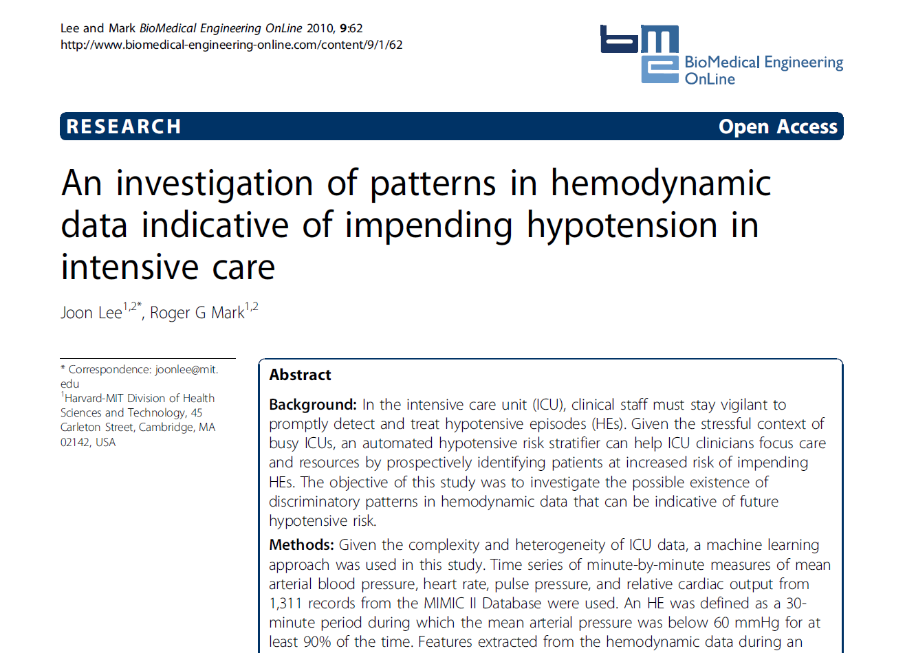
Use case two

Slide 83
Use case two
http://mimic.catalyzecare.org:3838/sample-apps/usecasetwo/

Slide 84
Revisit: Proposed architecture
Big Data
High Performance Computing
Analysis
Reproduce/Analysis
Publication
Publication
Evidence Based Medicine/FDA Approval

Slide 85
Issues to be addressed
Sustainability
Privacy/Security
Scalability

Slide 86
Questions

